Slide 1
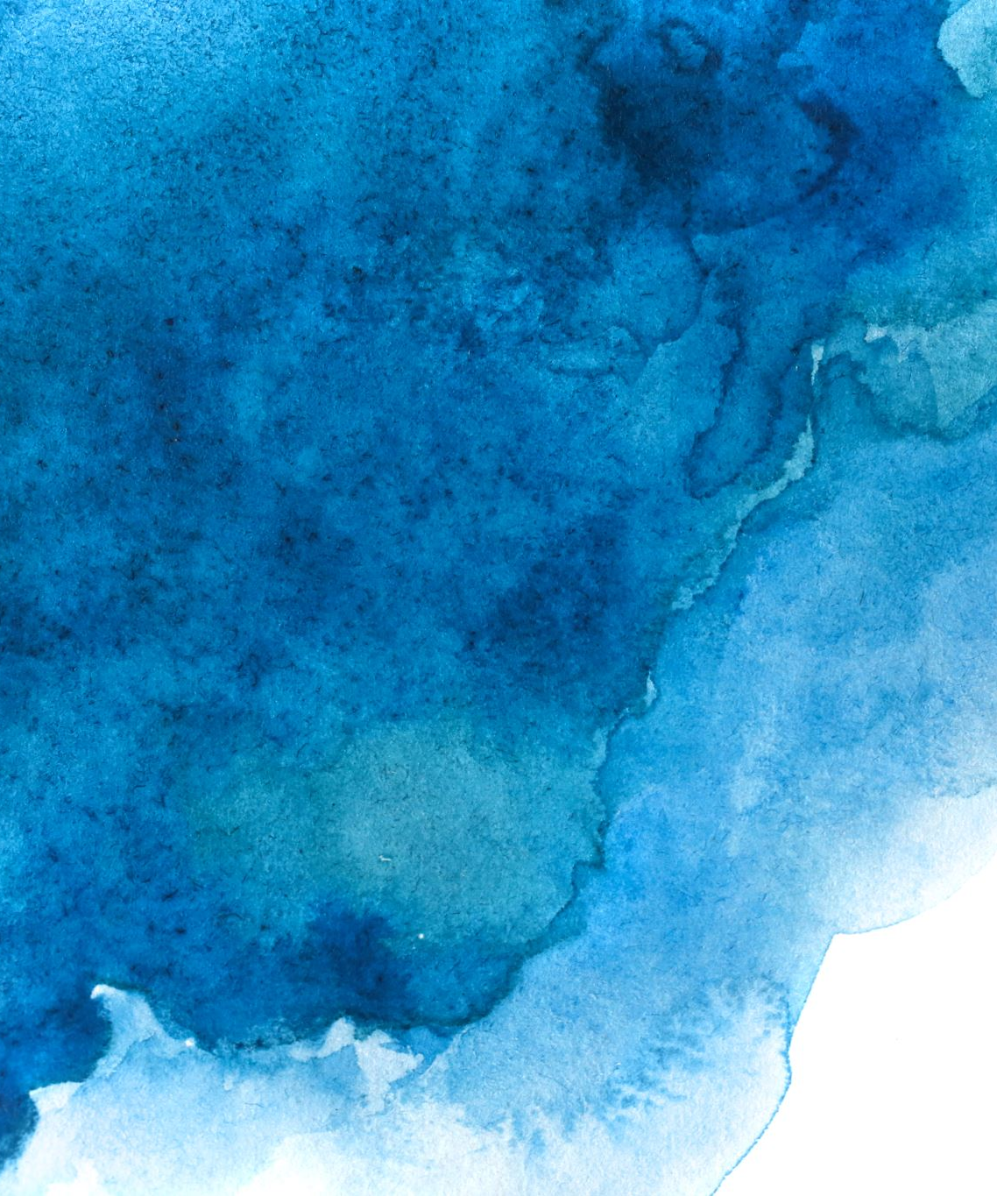
SAI SAROJA BHUPATHI B00116458
MONKEYPOX DIAGNOSIS Image Classification
A Deep Learning Approach

Slide 2
Introduction – Project Overview
Title: Pox Image Classification Using Deep Learning and Flask
Description: This project is about creating a simple web app that can identify different skin diseases—like Chickenpox, Measles, Monkeypox, or Normal skin—by looking at a photo. It uses a trained deep learning model with computer vision, TensorFlow, and Flask to give quick results right in the browser.

Slide 3
Background of the Project
Problem Statement: Finding skin diseases can take time and may not always be accurate. This project helps by using images to quickly and automatically find the disease.
Dataset Used: We used public images of skin diseases and resized them to 150x150 pixels to fit the model.
Model Algorithm: We created a CNN model that learns from images to detect diseases. It uses tools like Keras, TensorFlow, and OpenCV to predict if the skin is healthy or has Chickenpox, Measles, or Monkeypox.

Slide 4
Model Training – Insights
Training Details: The images were resized and adjusted to work well with the model, which was trained using the Adam optimizer and accuracy as the main measure. It learned for about 30–50 rounds (epochs) and used techniques like dropout and image changes to improve performance.
Findings: The model reached over 90% accuracy and worked best with clear, well-lit images. Using regularization and data changes helped avoid overfitting (memorizing instead of learning).

Slide 5
Operational Flow & Performance
Model Operation (Real-Time Image Upload): Users can upload a skin image, which gets resized and analyzed by the trained model to predict the disease along with how confident the model is.
Performance: The system gives results quickly (in 2–5 seconds) and works well in real-time, especially with clear and well-lit images.

Slide 6
Flask Web Application
Flask App Setup: The app has a simple web page where users can upload a skin image and see the predicted disease with a confidence score. Behind the scenes, the image is processed, and the result is shown on the same page.
Code Integration & Flask Route: The image is loaded and prepared using Python code, then sent to the model for prediction. Flask handles the upload and displays the result through the web interface.

Slide 7
Conclusion & Acknowledgement
Conclusion: We built a working web app that can quickly and accurately detect skin diseases from images using deep learning. It’s useful for fast health checks, even in remote areas.
Acknowledgements: Thanks to those who shared the datasets, supported the project, and guided the work. The app was made using TensorFlow, Keras, OpenCV, and Flask.

